Slide 1
PROJECT REPORT
STAT-515
Analysis of world's Leading Risk Factors for Death
Group no:8
By-
Prabhu Satya Kushal Mamillapally
Tanneru Sai Sushanth Chandra
Relangi Sree Hari Vasudev
Jyoti Mote

Slide 2
INTRODUCTION:
The world is changing remarkably over the past few years. The one persistent thing is at the end we die. The health care over the last 20 years has changed drastically.
The modern lifestyle, change in daily habits, improved infrastructure is also making us lethargic, as per the World Health Organization, approximately 60 – 85 percent of people around the globe lead to inactive lifestyles contributing health issues.
The leading causes of death across the world still vary significantly, it is crucial to understand what are the causes that lead to death and the risk factor related to a precipitous death.
The aim of this report is to analyze the data and find patterns in the deaths caused due to various risk factors.
We believe this project would help the government and organizations to focus on better policy making and targeted spending on health care.

Slide 3
Data Source:
The dataset consists of population of each country and data of number of deaths caused by the 12 risk factors responsible for the death over the last 17 years.
Column [Population] is separately taken from the UN official website.
Website: https://ourworldindata.org/causes-of-death

Slide 4
Attributes of the dataset:
[Country],[Year],Population],[Deaths_by_unsafe_sex],[Deaths_by_low_physical_activity],[Deaths_by_smoking],[Deaths_by_alcohol_consumption],[Deaths_by_drug_use],[Deaths_by_diabetes],[Deaths_by_high _blood_pressure],[Deaths_by_unsafe_water],[Deaths_by_unsafe_sanitation],[Deaths_by_air_pollution].
About the source:
Data taken from the below website:
https://ourworldindata.org/causes-of-death
https://www.un.org/en/
The website Our World in Data has data and research of that can help the world fight the bigger problems. They refer to the work of others as the team believes there is enough data available which is important and useful which goes inaccessible.
Our World in Data and the SDG-Tracker are collaborative efforts between researchers at the University of Oxford.

Slide 5
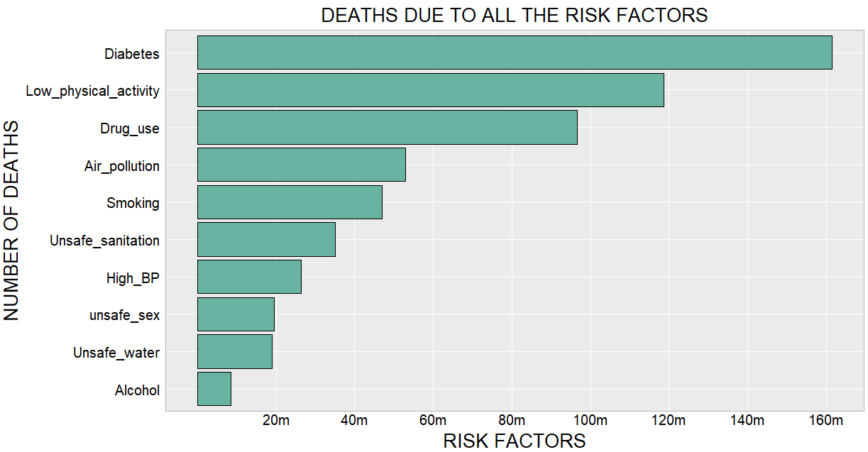
Number of deaths by risk factor:
Figure1: Total number of deaths by risk factors
Plot used: Bar Plot

Slide 6
Analyzed the most concerning factors and least concerning factors in the world.
The data taken is the sum of total number of deaths over the last 17 years.
The above plot shows that the number of people effected by diabetes has increased significantly in the last two decades.
We have used bar plot as each bar represents one value, to show the sum of total number of deaths for each factor bar plot was the best fit visualize the values.
When the bars are placed next to one another, it is easy to compare the and conclude that diabetes is the reason for maximum number of deaths (more than 160m) and alcohol for least number of deaths (8.5m)

Slide 7
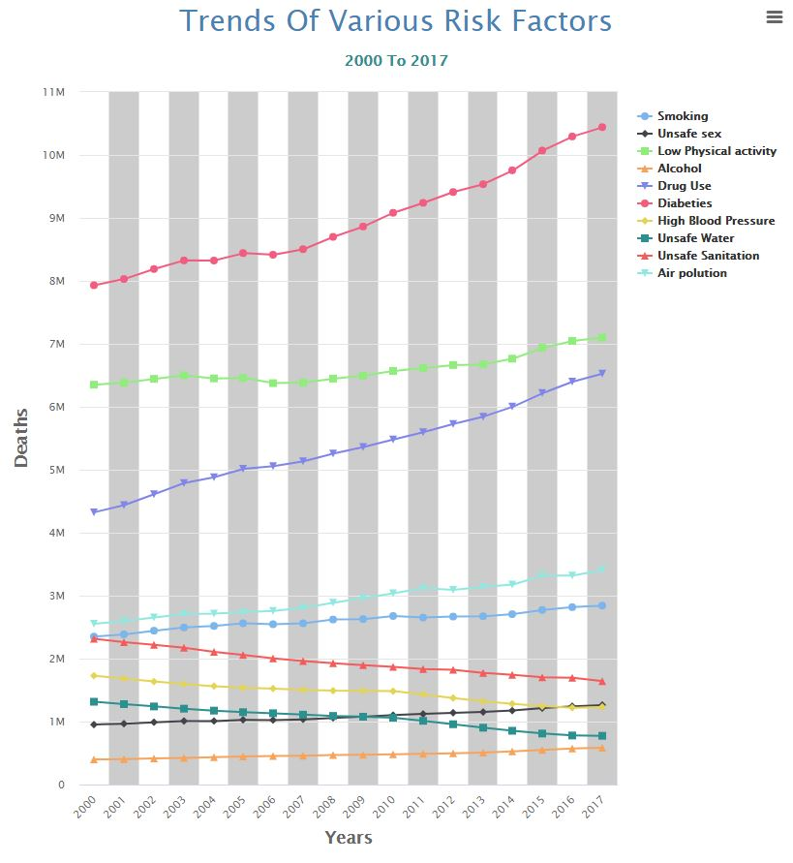
Death trends over 17 years:
Yearly death caused by different risk factors
Figure2: Yearly death caused by different risk factors
Plot used: Scatter plot

Slide 8
To observe yearly death trends by various factors , we have used interactive scatter plot.
It is the best method to show trends and range of data flow, we can easily determine the maximum and minimum deaths for each factor, observation and values are straightforward.
Positive trend seen in the number of deaths caused due to Diabetes, low physical activity, Drug use, Smoking, Unsafe sex, and Air pollution
No significant increase in the death rate due to Alcohol over the period of 17 years
Negative trend can be seen in the number of deaths caused due to High blood pressure, unsafe sanitation, and unsafe water.

Slide 9
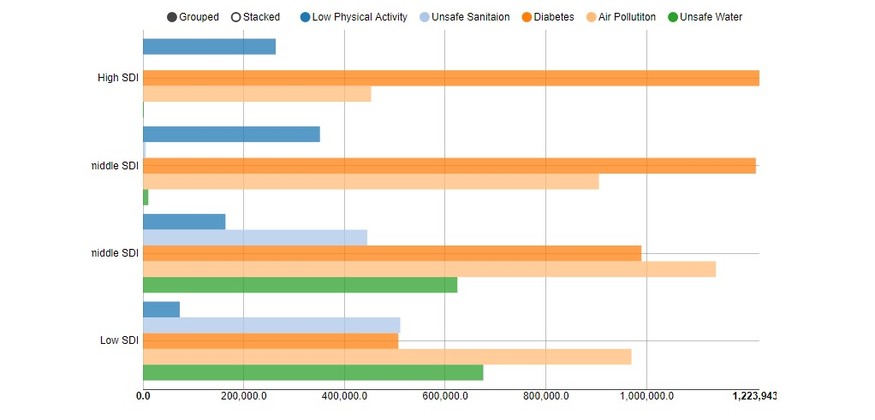
Death trends by SDI:
Figure 3: Trend of deaths in countries with different SDI
Plot used: Dodged Bar Plot

Slide 10
Interactive Dodged bar plot used to show the trend of deaths in countries with different SDI
The reason to consider below mentioned factors is that basic facilities such as good sanitation, clean air, safe water and health factors (i.e. Diabetes and Physical activity as they are playing a major role in deaths) are essential for sustainability.
The plot above is an interactive plot showing the trends in both stacked and bar plot, the legends are interactive where data can be seen by selecting different risk factors.
The main moto behind using this plot is we could categorize the countries based on their SDI as the countries with similar development will have similar SDI as it was difficult to compare different parameters for each country as there are 192 countries.
High SDI and High-Middle SDI countries, the deaths caused due to Diabetes, Air pollution and low physical activity are more. The deaths due to unsafe sanitation and unsafe water are negligible when compared to other 3 factors.
Along with Diabetes and Air pollution, the factors such as unsafe sanitation and unsafe water are major reasons for deaths in Low-Middle SDI countries.

Slide 11
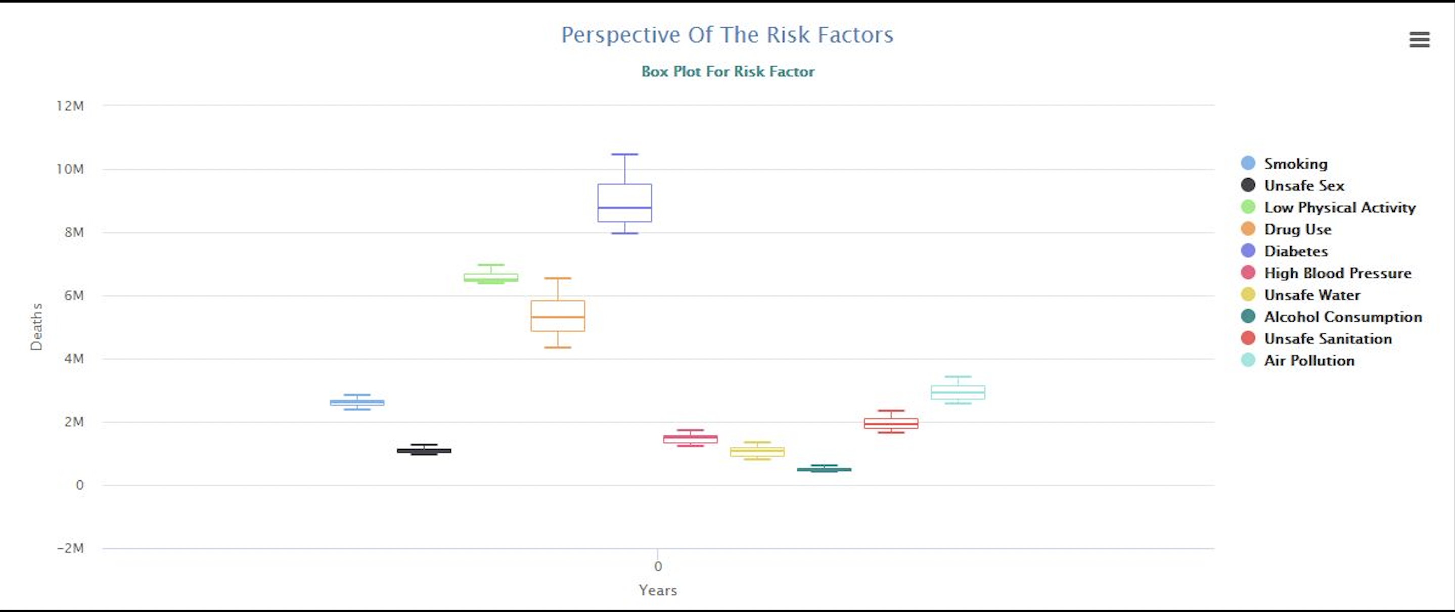
Perspective Of The Risk Factors

Slide 12
By looking at this Boxplot, there is a slow positive trend in few factors such as Diabetes, Low physical activity, unsafe sanitation.
There is high positive trend in Smoking, unsafe water, and high blood pressure. Rest of the other factors are growing at a normal rate. It is good to see that the rate of Diabetes, Low physical activity and unsafe sanitation is on a lower side.
It is also concerning to see that factors such as Smoking, unsafe water, and high blood pressure are on a higher side. It says that the situation can be brought under control if the governments and health organizations work together in making better policies and increase spending on health and basic facilities.

Slide 13
Conclusion:
It can be observed from Figure 1 that that the deaths due to Alcohol and Smoking are considerably low when compared to Diabetes, Drug use and Low physical activity.
Looking at the trends of death cases in Figure 2 for each of the factors, we can conclude that the deaths due to Diabetes, low physical activity, and Drug use are increasing at an alarming rate and the deaths due to unsafe sanitation, unsafe water, high blood pressure are decreasing gradually all over the world except in Low and Low-Medium SDI countries.
We can observe a trend in Figure 3 that the countries with high SDI suffer the most from diabetes and low physical activity. Deaths due to unsafe sanitation and unsafe water are negligible. People need to change the lethargic way of living and start living a healthy lifestyle. The governments of these countries can work on better policies to implement healthy way of living to decrease the death rates.
It can be suggested that focused spending on Health and sanitation along with better policies by the respective governments can drastically bring down the death rates due to all the factors discussed above.

Slide 14
Thank you

